Slide 1
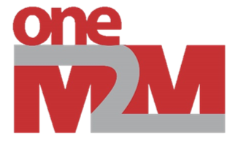
Federation: Multi-Vendor Internet of Things
Team 30: Adib Pournazari, Altay Adademir, Dennis Parchkov,
Edmond Ipindamitan, and Matthew Consterdine.

Slide 2
The Problem
This project is about the Internet of Things.
Vendors typically isolate their platforms.
Restricted interoperability leads to restricted functionality.
This limits what the end user can achieve.
A global Machine to Machine communication standard is needed.

Slide 3
oneM2M Standard
Introducing the oneM2M standard.
An open, global Machine to Machine communication standard.
Created by eight leading standard organisations.
Allows vendors to federate different data sources.
Adopted into many Internet of Things platforms, including…

Slide 4

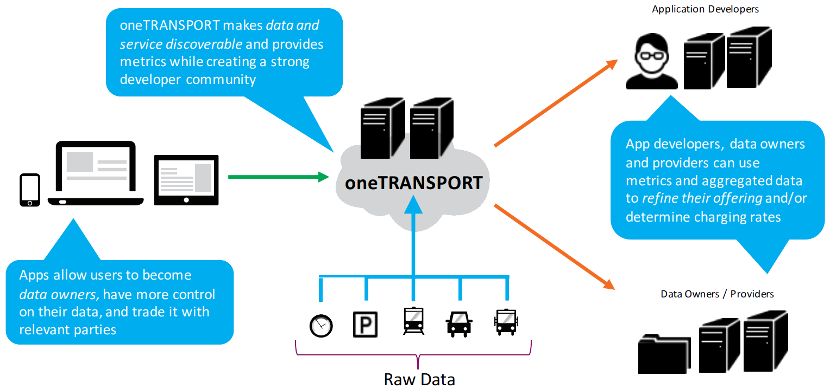
InterDigital’s oneTRANSPORT
A smart transport system by the projects client,
Currently interoperates with external service providers.

Slide 5
Primary Goals
Explore the practical applications of oneM2M federation:
Investigate open source oneM2M implementations.
Evaluate various hardware platforms.
Develop a plug-in integrating sensor data.
Deploy to hardware and the cloud.
Federation with our clients system.

Slide 6
Secondary Goals
Less critical, but still important:
Increasing data source complexity.
Adding secure connections.
Client authentication and access levels.
Interactive visualisation dashboard.

Slide 7
Project Scope
It is useful to define project scope. For this project:
A rich computing and communication environment is assumed:
→ HTTP is used instead of MQTT or CoAP.
Performance, efficiency or scalability aren’t a primary concern:
→ While they will be considered, this project is on a small scale.
This is primarily a research focused project.

Slide 8
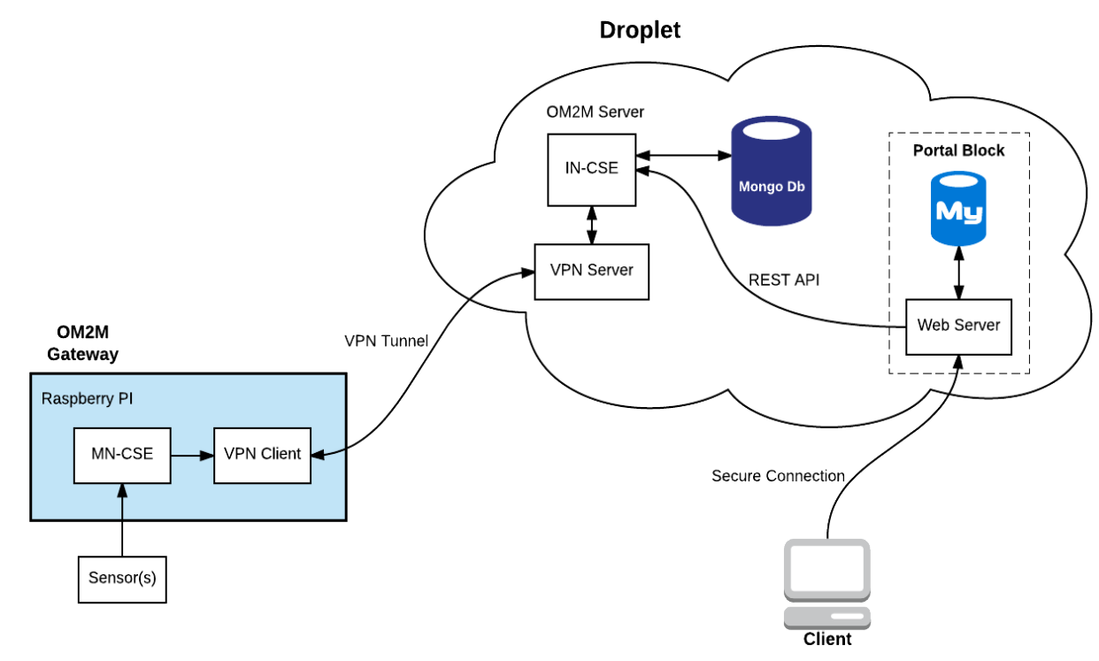
Initial Design
Designs change, but it never hurts to plan ahead.

Slide 9
Client Feedback
Taking into account feedback, the project’s aims changed:
Scrapping unnecessary features.
Removing the dashboard.
Produce a simple indoor demo.
Ensure ease of use.
Focus on federation.

Slide 10
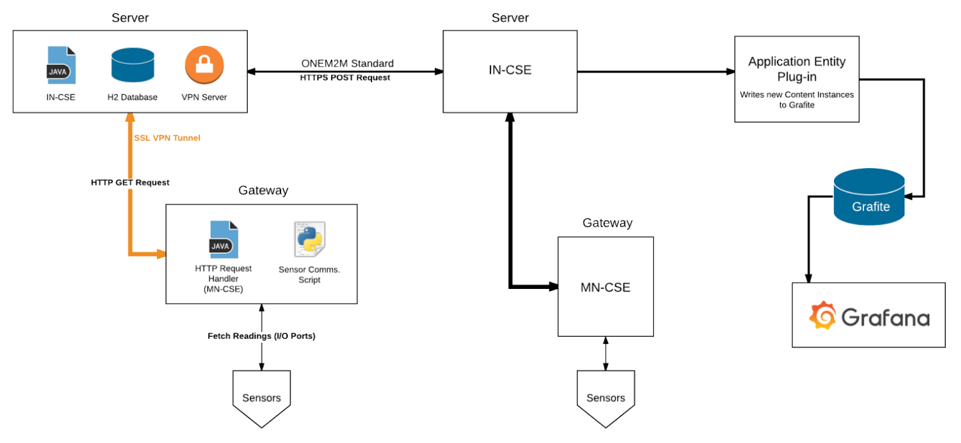
Final Design

Slide 11
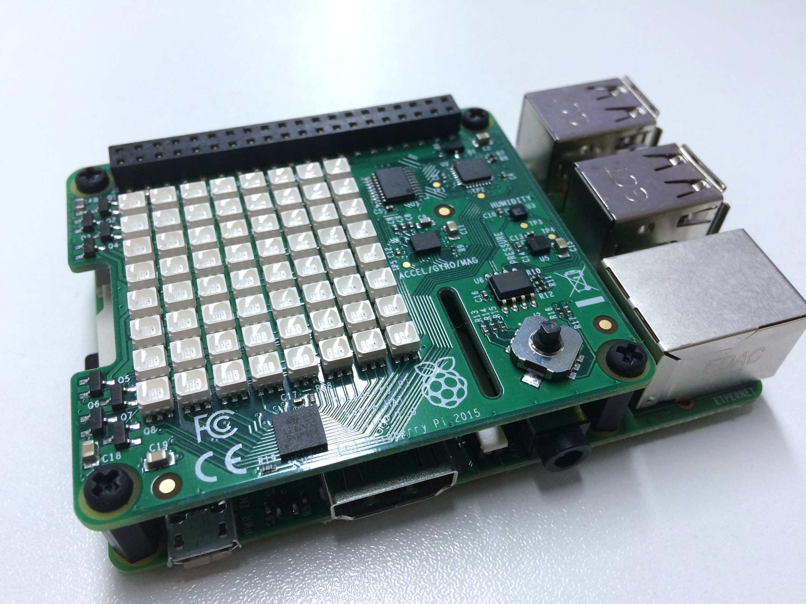
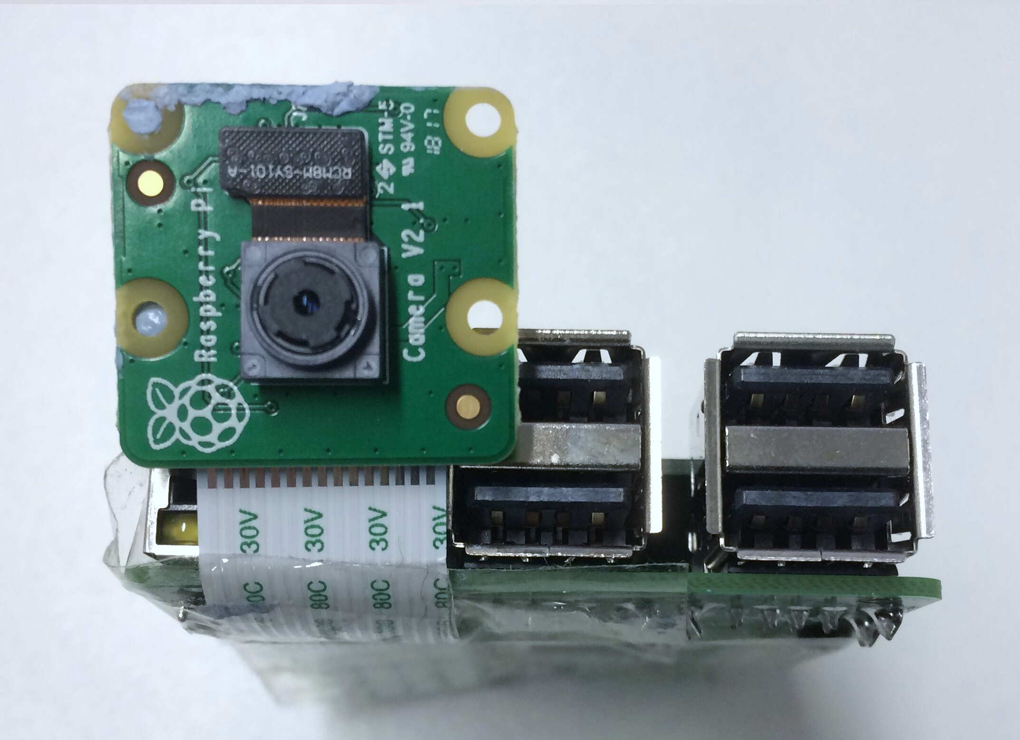
Raspberry Pi and Camera Streaming

Slide 12
Plug-in Implementation
Eclipse OM2M Plug-In
Provides an easy to use, web Interface.
Requires a single IDE leading to IDE configuration issues.
Little documentation, but plenty of guides and wiki articles.
OpenMTC Plug-in
No dashboard, so the Insomnia REST Client was used in place.
Simpler design lead to improved video streaming.

Slide 13
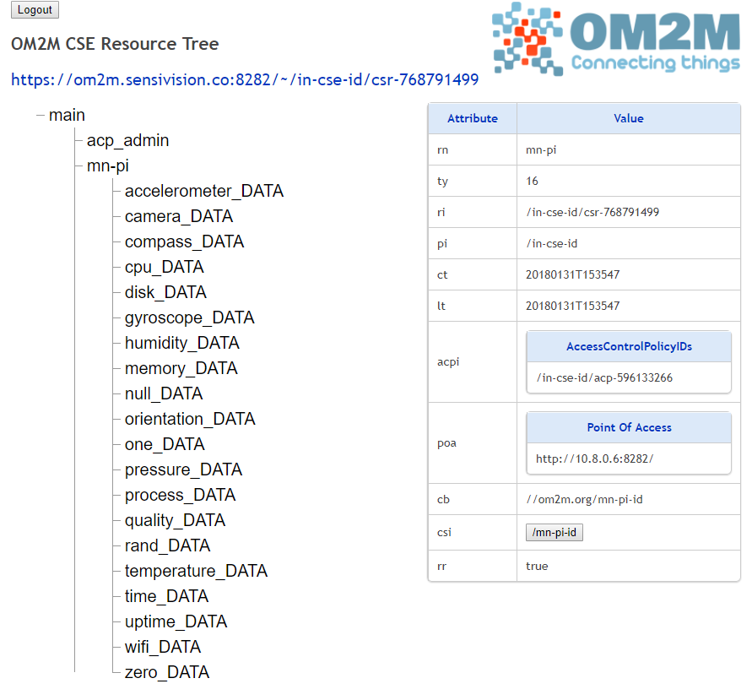
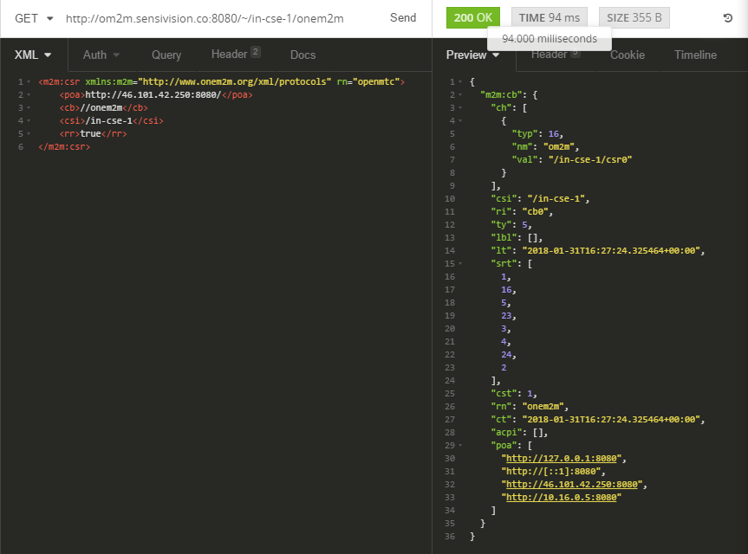
Development Tools
Eclipse OM2M CSE Resource Tree
The Insomnia REST client

Slide 14
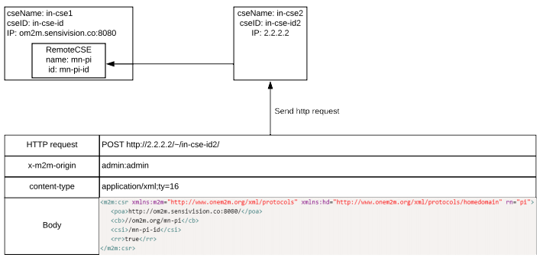
Achieving Federation
Federation was achieved by sending an XML REST request:

Slide 15
Testing
Untested code is untrusted code, so the team used many techniques to validate the different plug-ins:
Pair Programming.
Integration Testing.
Unit Testing.
Regression Testing.

Slide 16
Eclipse OM2M and OpenMTC Evaluation
The two plug-ins were evaluated, and certain key points emerged:
Development usability.
Interfacing with the different implementations.
Issues with adding HTTPS.
Video streaming performance.
Intra/Inter Federation.

Slide 17



Federation Evaluation
Between Eclipse OM2M and OpenMTC.
Between Eclipse OM2M/OpenMTC and oneTRANSPORT.

Slide 18
Future Work
As with any major project, there is always more to be done:
Federation mechanisms.
Increasing complexity.
CoAP and MQTT communication.
Alternate video streaming.
Dashboard visualisation.

Slide 19
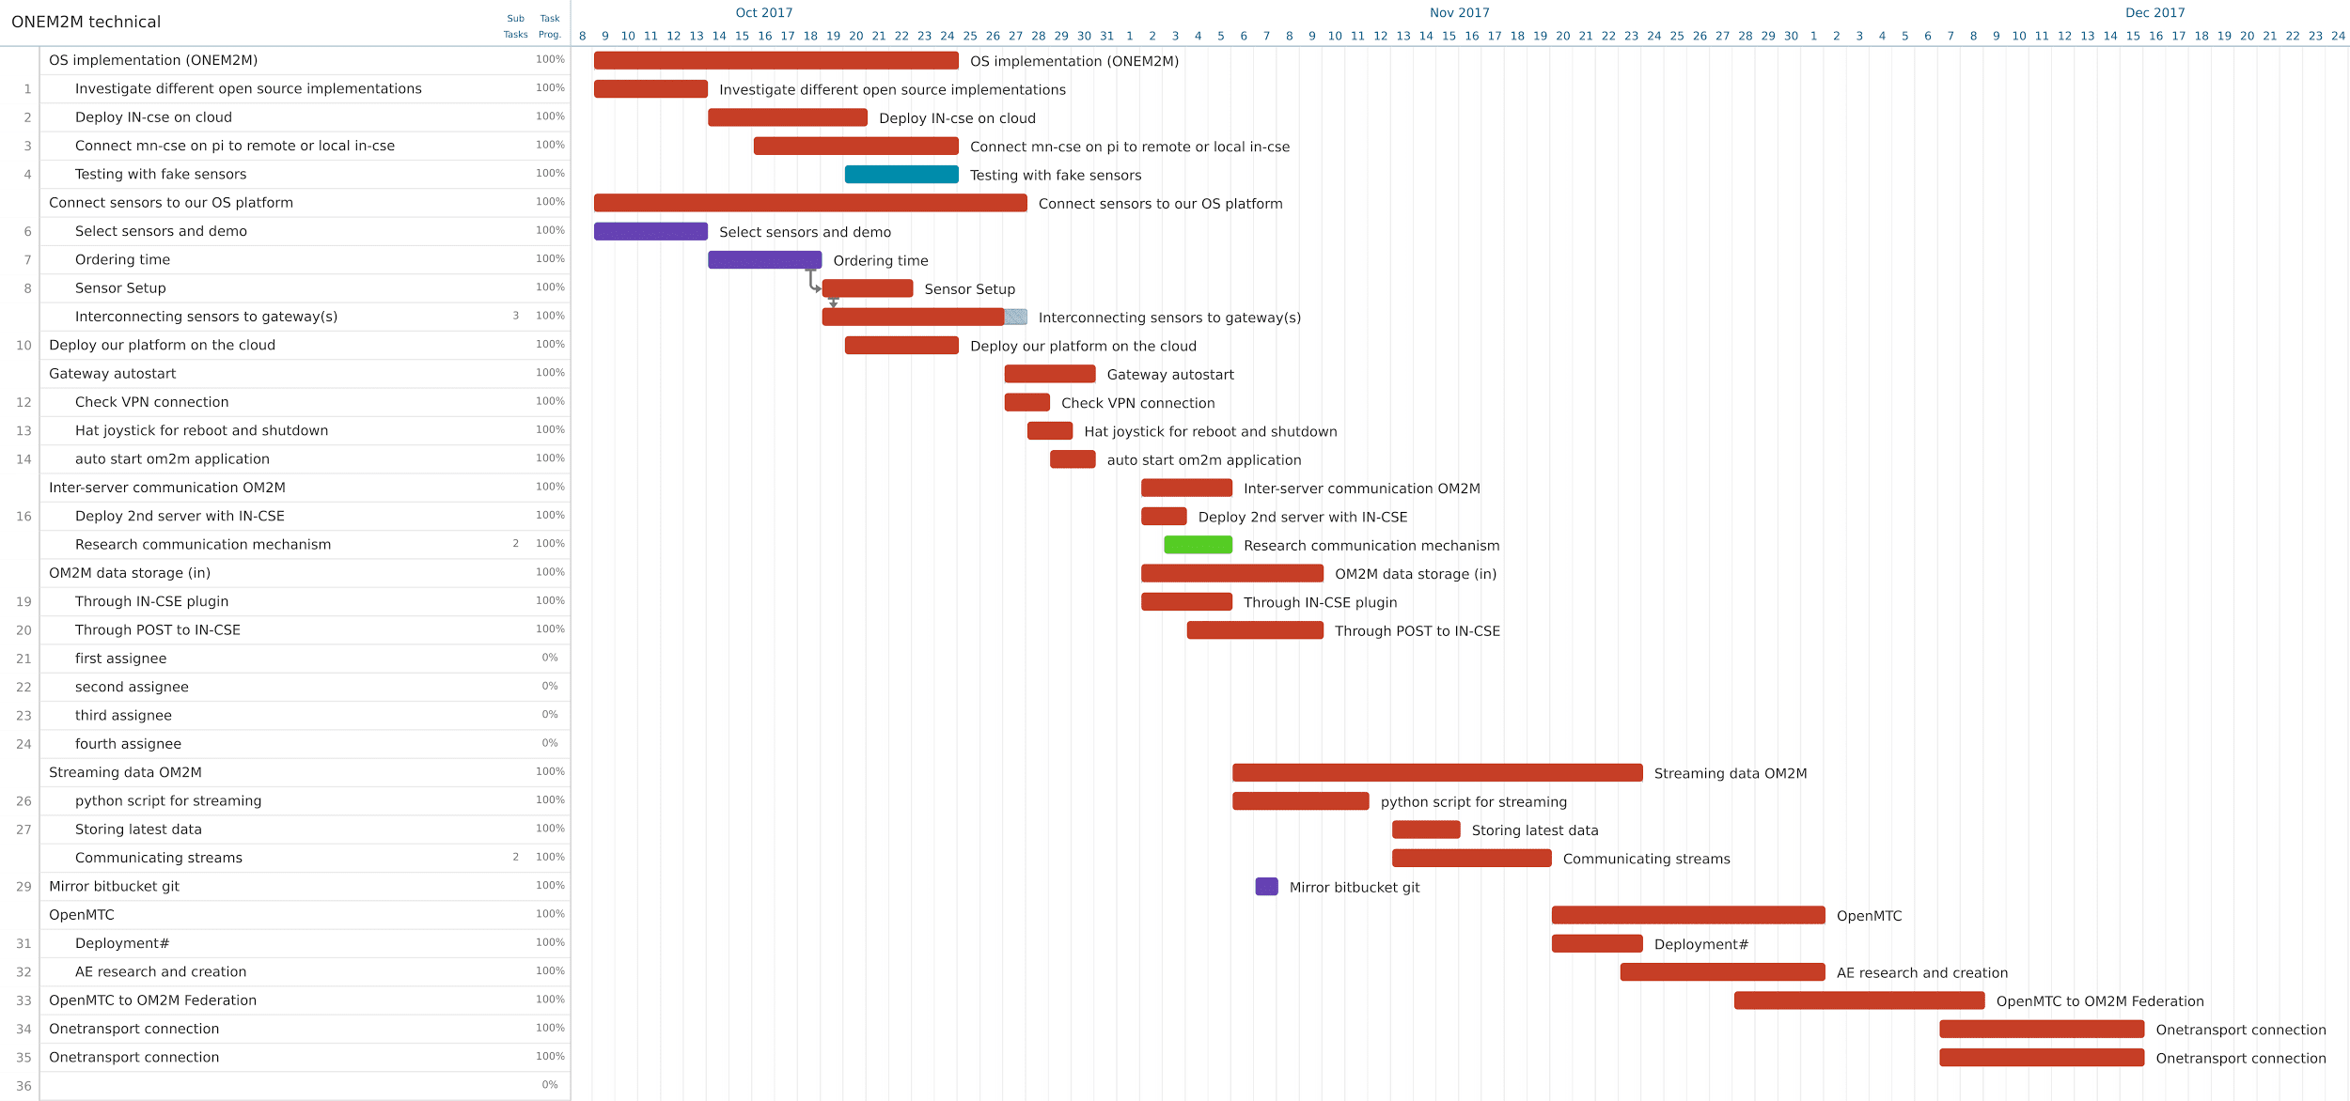
Project Planning

Slide 20
Thank you for listening
Any Questions?
Image Credits
City Render by Regiars, CC BYSA 3.0: https://commons.wikimedia.org/wiki/File:Территория "СМАРТ Сити Казань".jpg
Cloudy Sky by Matteo Fusco, Unsplash: https://unsplash.com/photos/m94kn8Rp61Q
Creating the Living Network by oneTRANSPORT: http://interdigital.com/download/56d5c75ae26228c7b700189c

